Slide 1
MAN VS BEE
THE PERFECT SOLUTION

Slide 2
GROUP DETAILS
GROUP MEMBERS
Ajay Krishna P
Amritha K
Athira P
Harikrishnan M
GUIDE NAME
Malihabi miss

Slide 3


Slide 4
MAN VS BEE
INTRODUCTION
“MAN VS BEE” we are introducing a new system for daily wage workers and this system also help full to public society and commercial dealers. Daily wage workers from different sectors can register in this app with their details. The public society can select the best workers for their needs with the help of public review and get the rich workers from all sectors under one roof. Commercial traders can register on it. Through it all the necessary materials for the wage laborers can be obtained through it and all the necessary materials for the construction sector of the public society should be ensured through it. This application is mainly divided into four parts(admin, Contributor, customers, E-commerce).

Slide 5
Admin. admin can control and co-ordinate.
Contributor. daily wage workers is the contributor, Daily wage laborers can register with their profile and they can give description about themselves and they can upload their working photos and videos to impress the customers.
Customers. Customers can choose the best workers by looking at many different fields of workers, their required workers, reviews, descriptions, ratings, and find the best workers and all the materials needed for work using this application.
E-commerce. All commercial dealers, big and small, can register with it so that they can expand their business through which customers and builders can easily get their desired products under one roof without much searching and get the best price.

Slide 6
FEATURES:
24*7 customer care service
FAQ
Suggestion
We can provide offers
Workers get easily
In same field wide collection of workers . we can filter based on review
All type of workers can get under one umbrella
Fast delivery
Easy return
Filter based on customer review
A to Z products available ETC……

Slide 7
EXAMPLE FOR WORKERS
Excavator, Waterproofer, Electrician,Plasterer, Plumber&drainer,Roofer, Gasfitter,Tiler, Concretor,Floor sander, carpenter,Painter, bricklayar,Landscaper etc….
EXAMPLE FOR PRODUCTS
Steel ,brick, sand ,paint, wood,plumping items etc…

Slide 8
Existing system
This society has a lot of applications, but it has some small problems.
Their features are not users friendly.
Using time has bugs
Very low bug detecting capacity or long time delay to fix bugs
Not timely delivery
Not easy return
Not user friendly
The availability of the worker’s product is also very low

Slide 9
Quality assurance is very poor
Limitations in filters
Very poor collection of product
Difficult to register
There is no option for cash on delivery
There is no option for estimate
Very poor customer care servies

Slide 10
Proposed system
24*7 customer care service
FAQ
We can provide offers
In same field wide collection of workers . we can filter based on review
All type of workers can get under one umbrella
Quick & Accurate delivery
Easy return

Slide 11
A to Z products available
Well customer care support
Easy to register
Advance filter
Wide collection of product with assured quality
Best price
100% customer satification
Accurate bug fixing
Estmation option
Cash on delivery available
We can provide well experianced workers

Slide 12
MODULES
1.Admin
2.Contributer
3.Customer
4.Shop

Slide 13
ADMIN
1.1 Login
1.2 Category management
1.3 View registered contributers and approved
1.4 View approved contributer
1.5 View rating and review
1.6 Block/unblock contributer
1.7 Work product management
1.8 View registered shop
1.9 View registered users
1.10 View complaint and send reply
1.11 Faq management

Slide 14
2. CONTRIBUTER
2.1 register
2.2 Login
2.3 View profile
2.4 View customer request
2.5 Request approved
2.6 View materials and add to cart
2.7 Book materials
2.8 Forward bill to customer
2.9 Send payment into to customer (work bill)

Slide 15
3. CUSTOMER
3.1 Register
3.2 Login
3.3 View profile
3.4 View category
3.5 View approved contribuers
3.6 Send work request &view rating
3.7 View request status
3.8 View bill
3.9 Payment
3.10 View previous bills
3.11 View work bill &payment
3.12 Send rating for contributer
3.13 Send review about contributer
3.14 Send complaint & view replay

Slide 16
4. SHOP
4.1 Register
4.2 Login
4.3 View profile
4.4 Stock updation
4.5 View orders &update status
4.6 View payment report

Slide 17
LEVEL 0

Slide 18
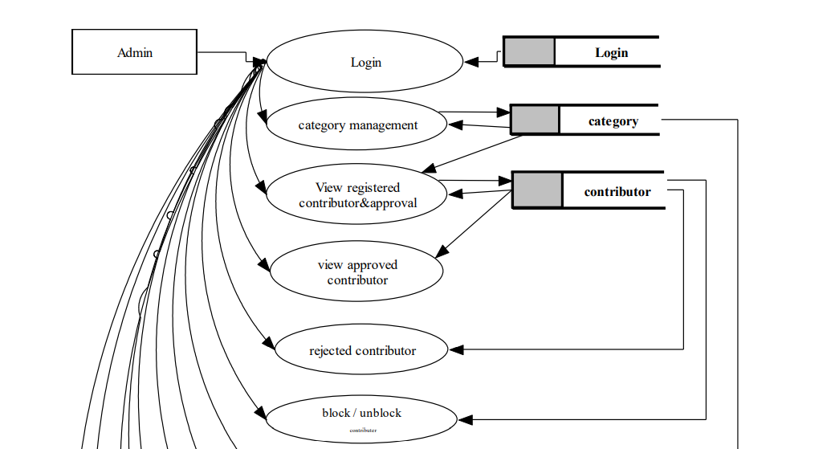
LEVEL1.1

Slide 19
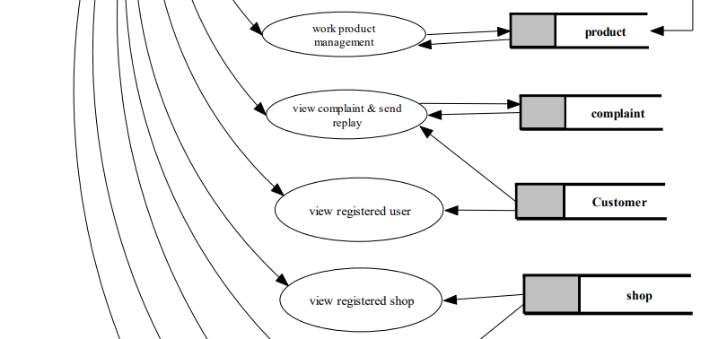

Slide 20
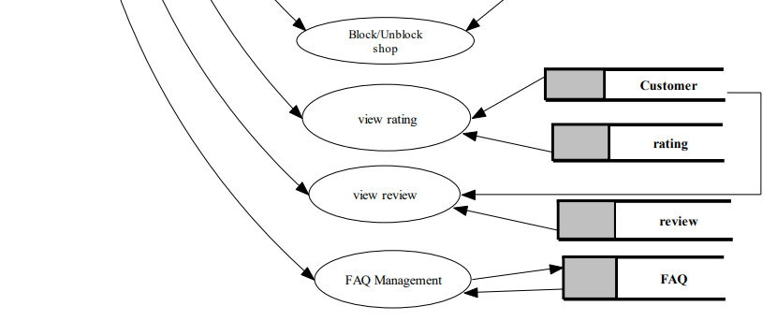

Slide 21
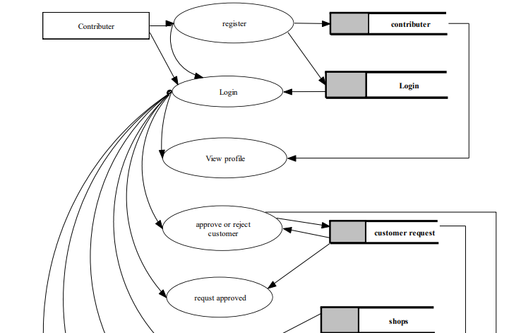
LEVEL1.2

Slide 22
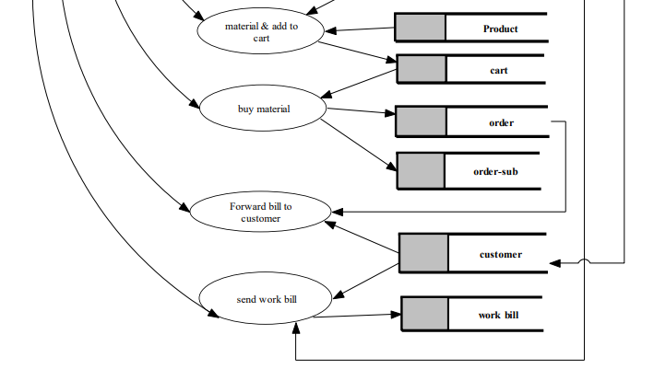

Slide 23
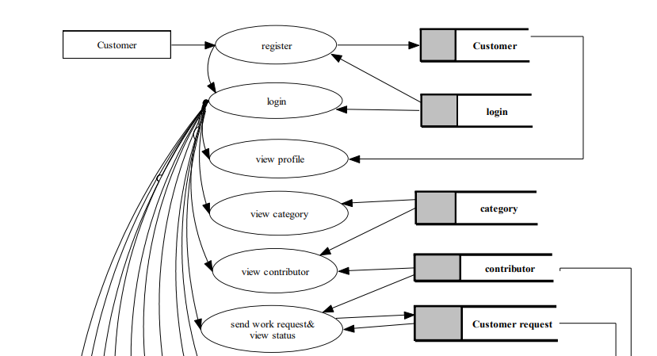
LEVEL1.3

Slide 24
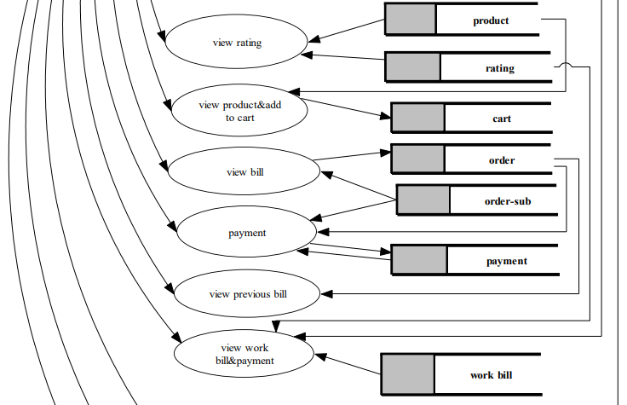

Slide 25
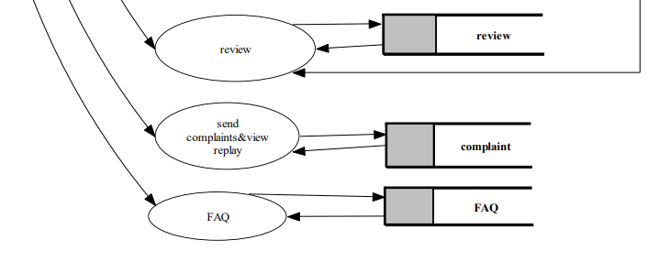

Slide 26
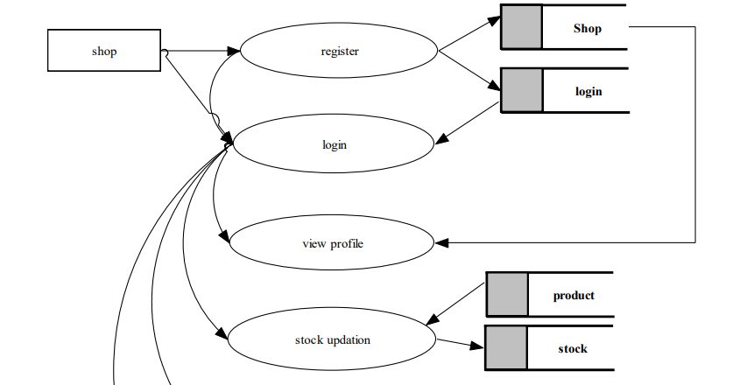
LEVEL1.4

Slide 27
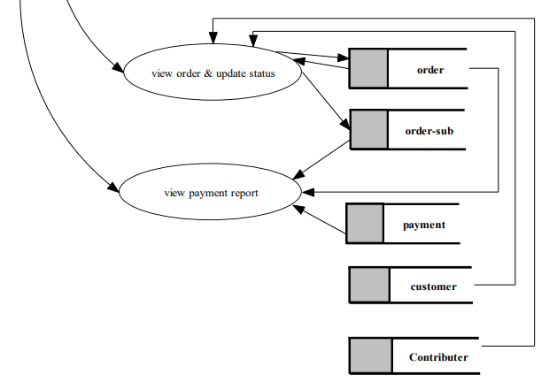

Slide 28
Database Design

Slide 29
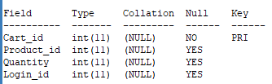

CART
CATEGORY

Slide 30
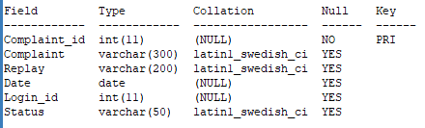
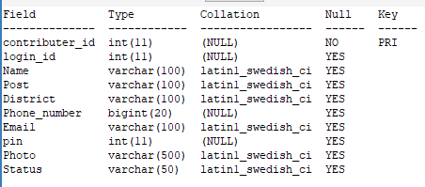
COMPLAINT
CONTRIBUTER

Slide 31
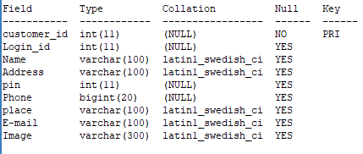
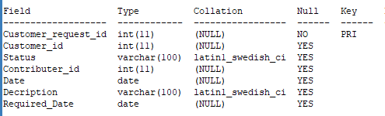
CUSTOMER
CUSTOMER_REQUEST

Slide 32
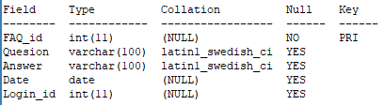
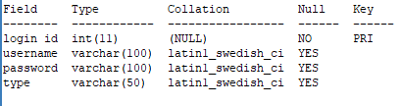
FAQ
LOGIN

Slide 33
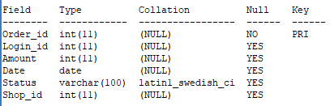
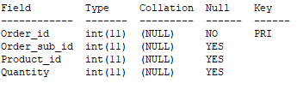
ORDER
ORDER_SUB

Slide 34
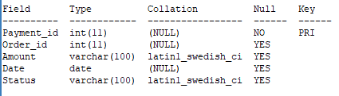
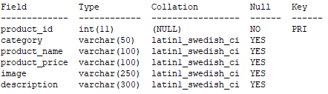
PAYMENT
PRODUCT

Slide 35
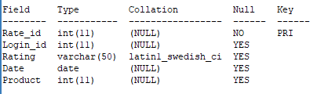
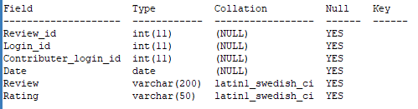
RATING
REVIEW

Slide 36
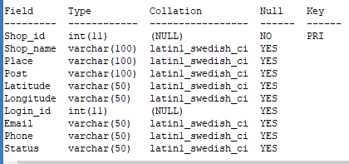
SHOP

Slide 37
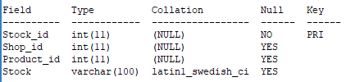
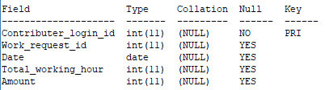
STOCK
WORK_BILL

Slide 38
SCREENSHOTS

Slide 39
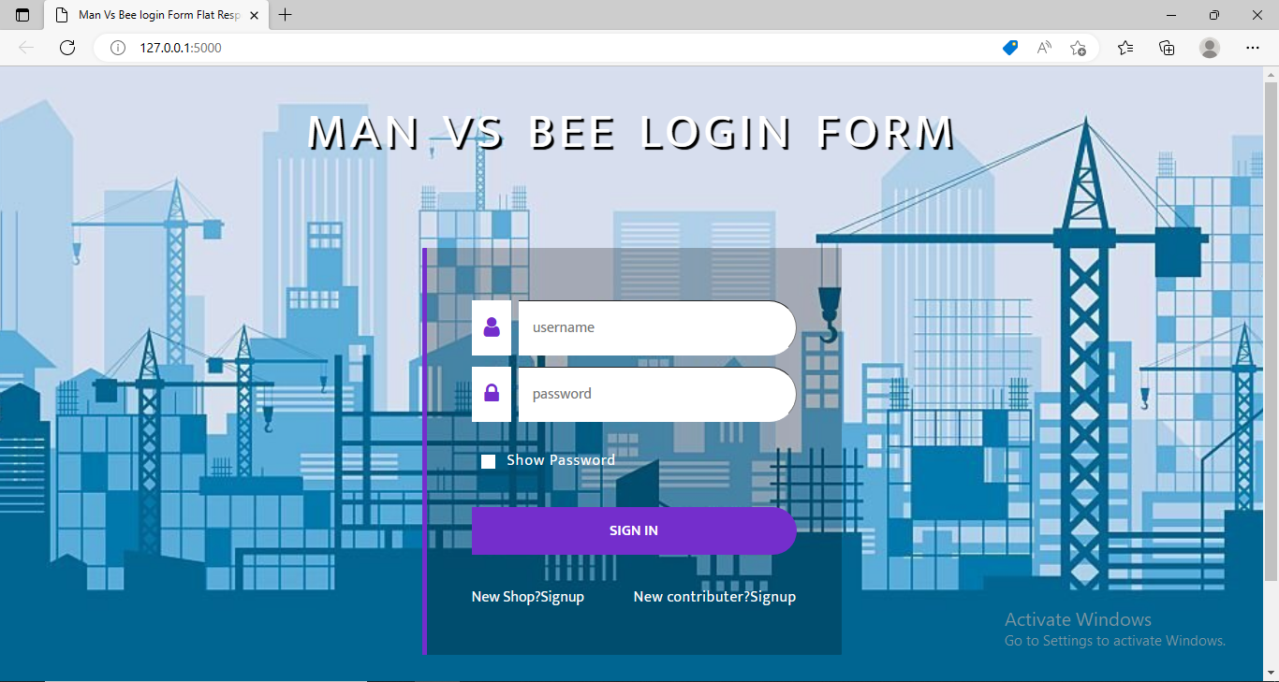

Slide 40
HARDWARE AND SOFTWARE REQUIREMENTs
This specifies the hardware and the support software required to carry out the development
Hardware Specifications
The selection of hardware is very important in the existence and proper working of any software. Then selection hardware, the size and capacity requirements are also important.
Processor : Intel i3 and above
System Bus : 32 Bit or 64 Bit
Primary Memory : 4GB RAM and above
Storage : 320 GB hard disk and above
Display : 14” LCD or Above
Key Board : Windows compatible
Mouse : Windows compatible

Slide 41
Software Specifications
One of the most difficult task is selecting software for the system, once the system requirements is found out then we have to determine whether a particular software package fits for those system requirements. The application requirement:
Front end : HTML,XML(web)
Language : Python
Back end : MySQL
Operating system : windows 7 or above
IDE : Jetbrains Pycharm , Android Studio
Software used : SQLyog, wamp server, Adobe Dreamweaver

Slide 42

thankyou

